Slide 1
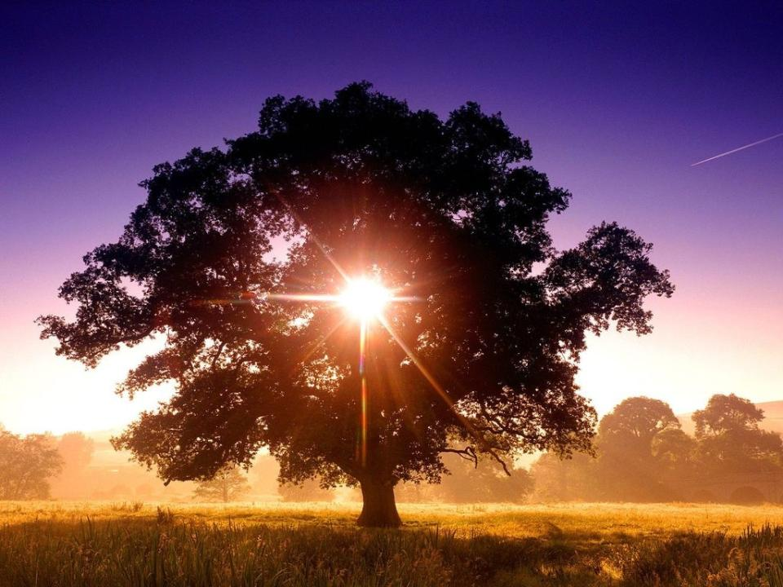
Bellingen 20 July 08
today’s images: Pip Wilson & Belial
Notes:
HONESTY ALERT:
I’ve included the powerpoints for the songs we sang, which we have licensing to project at church.
Almost every church does that has a projector, so I haven’t cut them out.
If you don’t have a license, don’t use them.

Slide 2
Call to worship
“…the Uniting Church enters into the inheritance of literary, historical and scientific enquiry which has characterised recent centuries, and gives thanks for the knowledge of God's ways with humanity which are open to an informed faith.
[we live] within a worldwide fellowship of Churches in which we will learn to sharpen our understanding of the will and purpose of God by contact with contemporary thought.
Within that fellowship we also stand in relation to contemporary societies in ways which will help us to understand our own nature and mission.
Basis chapter 11
Notes:
Read the overhead- Basis of Union. So come, let us seek God’s ways and reflect on our nature and purpose, remembering that God is always with us, in us and in all things.

Slide 3
You are before me, Lord, you are behind,
and over me you have spread out your hand;
such knowledge is too wonderful for me,
too high to grasp, to great to understand
Notes:
Together in Song #87

Slide 4
Then from your Spirit where, Lord, shall I go;
and from your presence where, Lord, shall I fly?
If I ascend to heaven you are there,
and still are with me if in hell I lie.

Slide 5
If I should take my flight into the dawn,
if I should dwell on ocean’s farthest shore,
your mighty hand will rest upon me still,
and your right hand will guard me evermore.

Slide 6
Search me, O God, search me and know my heart;
try me, O God, my mind and spirit try;
keep me from any path that gives you pain,
and lead me in the everlasting way. #
based on Ps 139
Ian Robertson Pitt-Watson 1923–95
Words © The Estate of I. R. Pitt-Watson Music © The Estate of D. Wright Smith

Slide 7
O LORD, you have searched me and known me.
You know when I sit down and when I rise up;
you discern my thoughts from far away.
Such knowledge is too wonderful for me;
it is so high that I cannot attain it.
Where can I go from your spirit?
Or where can I flee from your
presence?
If I ascend to heaven, you are there;
if I make my bed in Sheol, you are there.

Slide 8
If I take the wings of the morning
and settle at the farthest limits of the sea,
even there your hand shall lead me,
and your right hand shall hold me fast.
Search me, O God, and know my heart;
test me and know my thoughts.
See if there is any wicked way in me,
and lead me in the way everlasting.

Slide 9
Welcome
Notes:
Some extracts of the introduction I originally used in Bellingen in2008.
July 2008 marks 150 years since Darwin and Wallace read extracts from their papers on natural selection at the Linnean society. The sciences which reflect on the implications of evolution by natural selection are part of the “inheritance of literary, historical and scientific enquiry which help us build the kind of informed faith for which the UCA gives thanks.
Last fortnight we had the reading where Paul laments being trapped in a body of death, which makes him do what he thinks is wrong, and shy away from what is right. And I suggested today I’d reflect on that common human xp, in the light of what modern thinking can help us uncover about this “body of death.”
Which of course is a way of talking about salvation. And when I realised it was the 150th anniversary of Darwin’s presentation to the Linnean society about natural selection, it seemed to all fit together.
Hopefully even if your faith story starts with a literal reading of Genesis you will still come away with a deeper understanding of your nature and sense of your mission.

Slide 10
opening prayer
Notes:
God you search us and know us: closer to us than we are to ourselves. Loving us more than we love ourselves. Though we sense it through a glass, darkly, we confess your presence here with us. You are welcome here. May we have a sense of your presence this morning, and come away with a better sense of our nature and mission.
In the silence we confess your presence, and the times we have lost sight of it, and acted out of Paul’s body of death.
Minute Silence.

Slide 11
We are one in the Spirit, we are one in the Lord.
We are one in the Spirit, we are one in the Lord.
And we pray that all unity may one day be
restored.
Notes:
On evolution Sunday is seemed helpful to have a song stressing unity
Public domain according to http://www.higherpraise.com/lyrics1/We_Are_One_In_The_Spirit.htm which also has the chords
Cant find the source for this cloud photo sorry

Slide 12
And they'll know we are Christians
By our love, by our love,
Yes they'll know we
are Christians by our love.

Slide 13
We will walk with each other, we will walk hand in hand.
We will walk with each other, we will walk hand in hand.
And together we'll spread the news that God is in our land.

Slide 14
And they'll know we are Christians
By our love, by our love,
Yes they'll know we
are Christians by our love.

Slide 15
We will work with each other, we will work side by side.
We will work with each other, we will work side by side.
And we'll guard each one’s dignity and save each one’s pride.

Slide 16
And they'll know we are Christians
By our love, by our love,
Yes they'll know we are Christians by our love.

Slide 17
So all praise to the father from whom all things come And all praise to Christ Jesus, his only son,
And all praise to the spirit
who makes us one.

Slide 18
And they'll know we are Christians
By our love, by our love,
Yes they'll know we
are Christians by our love.
#

Slide 19
If I were a butterfly I’d praise you God by flashing my wings And if I were a bowerbird I’d make a blue house for you to observe And if I were a fish you see I’d wiggle my tail and I’d giggle with glee
But I am a human its alright by me!
Notes:
The original is creationist, and I’ve always found it a dodgy theology that God makes us the way we are, especially from time spend with people with mental illnesses, and major, painful congenital birth defects.
On the other hand, the words I’ve got here don’t fit all that well, so feel free to pull them apart, and send me an improvement.
Or, just use the old one as a launching off point for how our theology has changed, and why that’s a good thing
And if you have any congregants who will freak out at the suggestion that God is no more Father than Mother, catch out for verse 2.
These lyrics are a draft really, so do whatever you like with them.

Slide 20
For they all are our kin And they’re all loved by you
but with our big brains humans can love you too
And I just thank you Father For speaking to me.

Slide 21
If I were a kookaburra I’d worship you with lots of laughta!
And if I were a kangaroo You know I’d hop right up to you;
And if I were a platypus I’d praise you God with my good looks
But I am a human its alright by me!

Slide 22
For they all are our kin And they’re all loved by you
but with our big brains humans can love you too
And I just thank you Mother For loving ‘lil me.

Slide 23
If I were a lizard now I’d be so fast I’d make you proud!
And if I were a mammal: boy I’d have a great dream for you to enjoy!
And if I were a dolphin strong I’d sing you one of my beautiful songs
But I am a human its alright by me!

Slide 24
For they all are our kin And they’re all loved by you
but with our big brains humans can love you too
And I just thank you Spirit For living in me. #

Slide 25
offering

Slide 26
For the life that you have given, for the love in Christ made known,
with these fruits of time & labour, with these gifts that are your own:
Notes:
Together in Song # 774

Slide 27
here we offer, Lord our praises; heart and mind & strength we bring;
give us grace to love and serve you, living what we pray and sing.
#
Carl P. Daw, Jr.
1944-
Words: Carl P. Daw, Jr.
Words © 1990 by Hope Publishing Co., Carol Stream, IL 60188.
All rights reserved. Used by permission.

Slide 28
kids
Notes:
I started by asking if they had heard of Darwin, or evolution?
Then I got them to act out being the following things:
A sea sponge – reptile – mammal – primate – human child – human adult.
Explain how each of those things are still in us, they are our ancestors.
Most Christians now believe that this is true, but what to make of this truth, how it helps us, is what we are still trying to work out.
Then I ad libbed something based on this Reflection, which I originally used for adults at the Adelaide ecofaith community
You are a lizard. Your great great great… grandparent. Running on instinct. Seeking safety, sustenance, sex. Fight, or flight, or freeze. That’s it. Because you survive, your descendents will be able to throw a ball or ride a bike without thinking. They will be attuned to danger before they even see it coming.
You are a mammal, one of the earliest. You live on the legacy of your reptile ancestors. But your brain also lets you feel. It lets you dream at night. No reptile ever did that, all mammals do. Every urge, grief, joy, sense of bonding and love begins with you. Because feelings helped you survive, your descendents will feel too.
You are a human child. Like other primates, your brain lets you think ahead. You can think, “If I do this, that might happen,” rather than having to try it. The more stable your environment, the more likely you are to be right. In a changed environment, thinking turns to worrying. Something lizards don’t do.
You can choose between desires. You are a social being: you love others. Love them enough to want them to love you. Want it bad enough to lie to them so they don’t stop loving you. Lizards don’t lie, but you do. We lie because we love, and want to be loved.
You are you. You at 20 or 30. Your brain is super connected, and your prefrontal areas matured. Self awareness, planning, the ability to have a vision, a long term desire and purpose which (at least often) overshadows the power of other areas of the brain. The ability to plot and plan and strive for great good or great evil is yours. To see that a fear is misplaced, or an emotion unnecessary. From here on the possibilities for integration are immense. What a pity you didn’t wait until now to hit puberty!
Take a moment to thank and celebrate your ancestors, the survivors. Every one of your ancestors survived, and lives in you.
Take a moment to celebrate you. This strange mix of instinct, emotion and thought.

Slide 29
Spirit of God in the clear running water Blowing to greatness the trees on the hill.
Notes:
Copyright details at http://ehymnbook.org/CMMS/hymnSong.php?folder=p25&id=pd25646
Hear it here http://www.myspace.com/bobrowe2/music/songs/spirit-of-god-in-the-clear-running-water-73590714

Slide 30
Spirit of God in the finger of water. Fill the earth, bring it to birth, and blow where you will.
Blow, blow, blow till I be but the breath of the Spirit blowing in me.

Slide 31
Down in the meadows the willows are moaning Roos in the pastureland cannot lie still.

Slide 32
Spirit of God, creation is groaning. Fill the earth, bring it to birth, and blow where you will.
Blow, blow, blow till I be but the breath of the Spirit blowing in me.

Slide 33
Spirit of God every one’s heart is lonely Watching and waiting and hungry until

Slide 34
Spirit of God, we long that you only Fill the earth, bring it to birth, and blow where you will.
Blow, blow, blow till I be but the breath of the Spirit blowing in me. #
Notes:
Kids leave as we finish the song

Slide 35
notices

Slide 36
Prayers for others

Slide 37
romans
Notes:
Using Paul’s body of death struggles, and the groaning of creation: NRSV version follows…
Romans 7 & 8
I do not understand my own actions. For I do not do what I want, but I do the very thing I hate…
I can will what is right, but I cannot do it. For I do not do the good I want, but the evil I do not want is what I do. Now if I do what I do not want, it is no longer I that do it, but sin that dwells within me.
So I find it to be a law that when I want to do what is good, evil lies close at hand. For I delight in the law of God in my inmost self, but I see in my members another law at war with the law of my mind, making me captive to the law of sin that dwells in my members.
Wretched man that I am! Who will rescue me from this body of death? Thanks be to God through Jesus Christ our Lord!
So then, we are no longer in debt to our sinful nature, because living according to the sinful nature brings death. But if by the Spirit you put to death the deeds of the body, you will live…
Romans 7 & 8 continued
For all who are led by the Spirit of God are children of God. We did not receive a spirit of slavery to fall back into fear, but a spirit of adoption.
When we cry, "Daddy! Daddy!" it is that very Spirit bearing witness with our spirit that we are children of God, and if children, then heirs, heirs of God and joint heirs with Christ -- if, in fact, we suffer with him so that we may also be glorified with him.
I consider that the sufferings of this present time are not worth comparing with the glory about to be revealed to us. For the creation waits with eager longing for the revealing of the children of God;
For the creation was subjected to futility, not of its own will but by the will of the one who subjected it, in hope that the creation itself will be set free from its bondage to decay and will obtain the freedom of the glory of the children of God.
We know that the whole creation has been groaning in labour pains until now; and not only the creation, but we ourselves, who have the first fruits of the Spirit, groan inwardly while we wait for adoption, the redemption of our bodies.

Slide 38
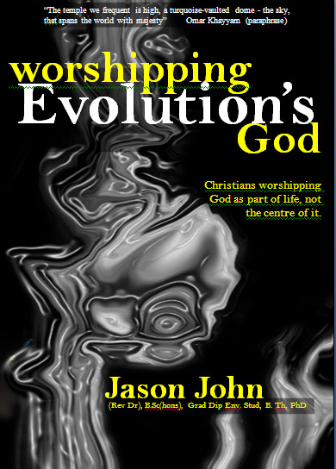
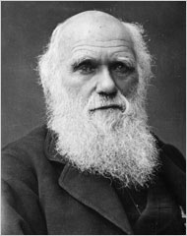
sermon
Notes:
Hmmm. I’m pretty sure I based it on the chapter, “Our Brains, can’t live with em, can’t live without em” from Worshipping Evolution’s God (ecofaith.org/books). And maybe also the preceding one, “Original sin or original need.”
You could use the video, “Animals inside” at http://ecofaith.org/evolutionsunday/

Slide 39
Notes:
From Michael Dowd, Thank God for evolution
http://www.thankgodforevolution.com/

Slide 40
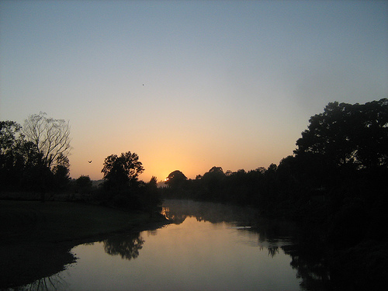
Notes:
Reflection after Sermon:
prayer/reflection
picture a sunrise (East symbolises the recent past, where the sun rose earlier in the day): Confessing the past. You did what you could do. Given the development of your instinct, emotions and rationality, you did what you did, what you had to do. You did do it.
Picture of Bellinger River, Jason John, copyleft.

Slide 41
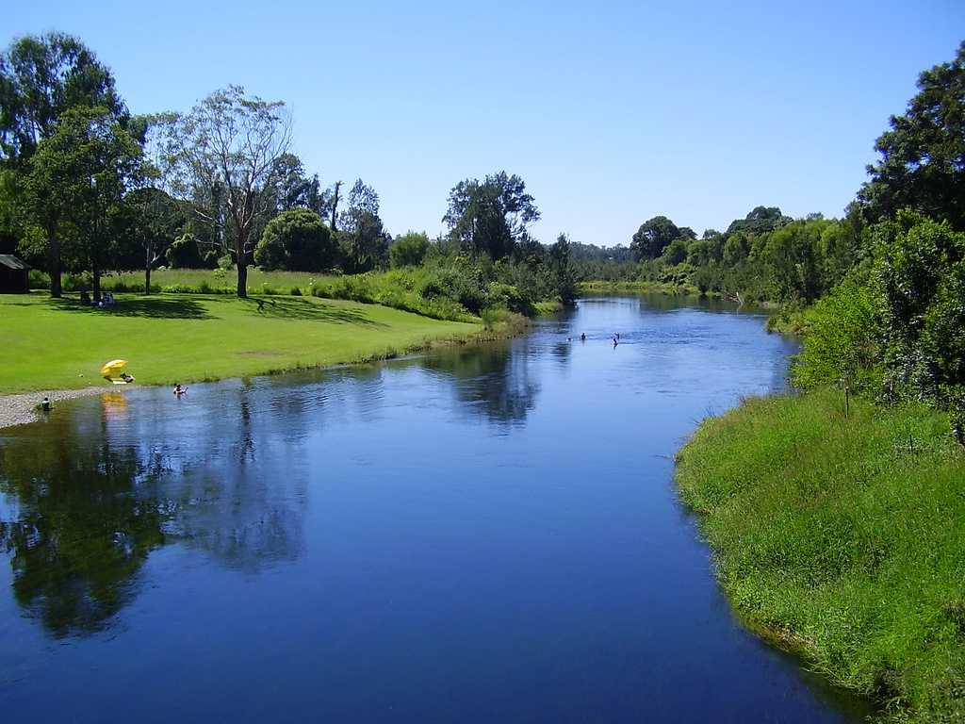
Notes:
Picture the middle of the day (the present, with the sun overhead): Now, you will do what you can do. Given the development of your instinct, emotions and rationality, if something threatens you, you will react as you must.
As far as I can remember, picture by Jason John

Slide 42
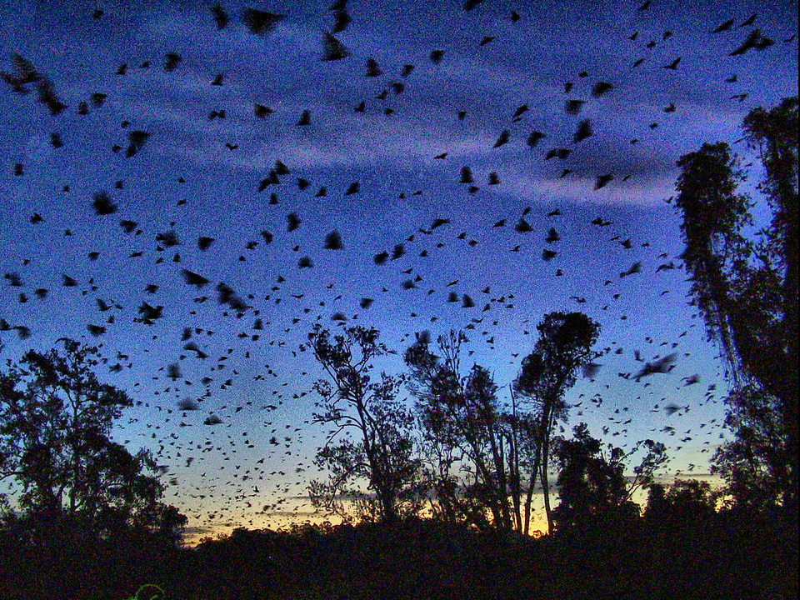
Notes:
Picture sunset (the near future, where the sun will set later): But in the future, you might do things differently. Instinct responds to practice. Emotions can be soothed in advance of threats. Rational thought can be ready to intervene quicker. The mammal can moderate the reptile. The primate can reflect on the mammal. The human can hold all things in balance, consciously call on the God of love to flow through our life. Purpose, vision, goals can call upon and work with instinct and emotion and thought. You did do things. You needn’t do them again. You need not be what you were.
Picture unknown

Slide 43
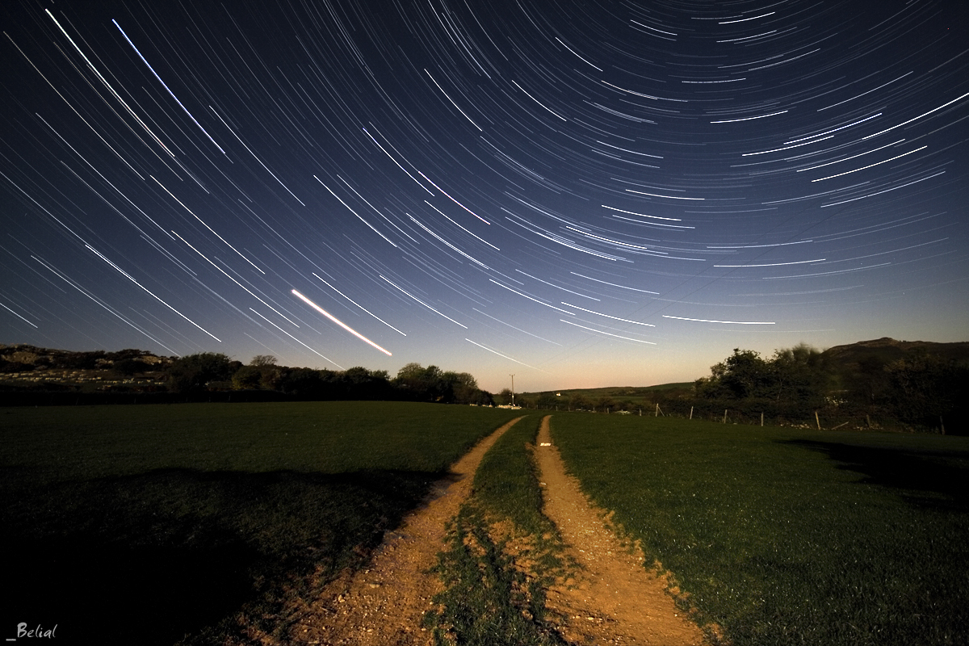
Notes:
Picture night (the far future beyond our lifespan, when the sun is set and darkness comes)
When your time on earth has ended, how will you have achieved your higher purpose? What legacy will you have left? What is your part in the call to revere life and participate in its evolution: to set it free?
Picture by unknown

Slide 44
Loving Spirit, loving Spirit, you have chosen me to be – you have drawn me to your wonder, you have set your sign on me.
Notes:
Together in Song #417

Slide 45
Like a mother you enfold me, hold my life within your own, feed me with your very body, form me of your flesh and bone.

Slide 46
Like a father you protect me, teach me the discerning eye, hoist me up upon your shoulder, let me see the world from high.

Slide 47
Friend and lover, in your closeness I am known and held and blessed: in your promise is my comfort, in your presence I may rest.

Slide 48
Loving Spirit, loving Spirit, you have chosen me to be – you have drawn me to your wonder, you have set your sign on me. #
Shirley Erena Murray
CAL Licence No. 200
Further copying prohibited.

Slide 49
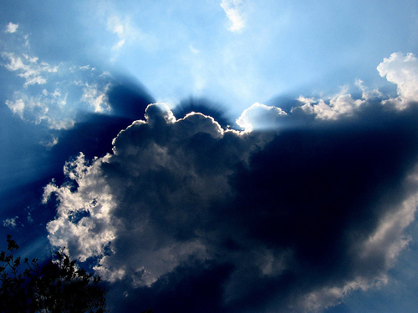
Blessing

Slide 50
Come as you are: that’s how I want you. Come as you are; feel quite at home, close to my heart, loved and forgiven. Come as you are: why stand alone?
Notes:
Picks up the “if I were a butterfly” themes. I like the repetition of the images from the reflection

Slide 51
No need to fear, love sets no limits; no need to fear, love never ends; don’t run away shamed and disheartened, rest in my love, trust me again.

Slide 52
I came to call sinners, not just the righteous; I came to bring peace, not to condemn. Each time you fail to live by my promise, why do you think I’d love you the less?

Slide 53
Come as you are: that’s how I love you; come as you are, trust me again. Nothing can change the love that I bear you; all will be well, just come as you are. #
Deirdre Brown.
AL Licence No. 200
Further copying prohibited.

